Slide 1
CS61065: Theory And Applications of Blockchain
Blockchain Security
Shamik Sural
shamik@cse.iitkgp.ac.in

Slide 2
Risks
Risk
Common Risks
Specific Risks
Blockchain operation mechanism
(Blockchain 1.0, 2.0)
Development, deployment and execution of smart contract
(Blockchain 2.0)
https://www.sciencedirect.com/science/article/pii/S0167739X17318332?casa_token=-Os8D6Mop7AAAAAA:NU-biO_avee1LRnqJ-6Aycw3yoQWhcWle0WdXaha3O-Dl2qPgl6EBZ0laOiJQQPpyi_6lVZ_ig8
2

Slide 3
Risks
Risk
Blockchain operation mechanism
Smart contract execution
51% vulnerability
Criminal smart contract
Private key security
Vulnerabilities in smart contract
Criminal activity
Under-optimized smart contract
Double spending
Under-priced operations
Transaction privacy leakage
2

Slide 4



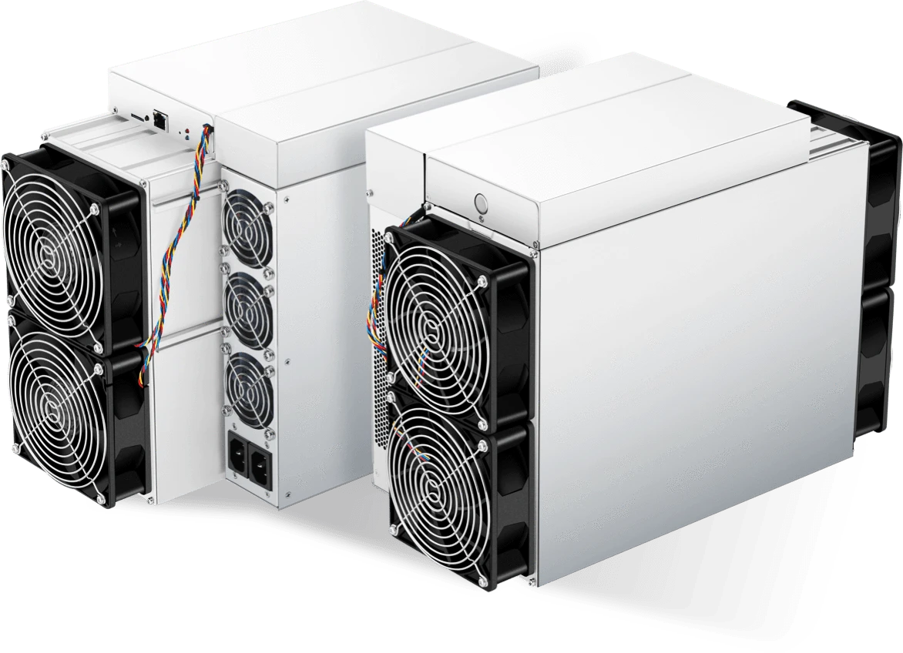

Common Risk: 51% vulnerability
Hashing power
Block 10
Block 11
Block 12
Block 13
Block 11'
Block 12'
Block 13'
Block 14'
Hashing power
3

Slide 5

Common Risk: 51% vulnerability
Coins
Block 10
Block 11
Block 12
Block 13
Block 11'
Block 12'
Block 13'
Block 14'
Coins
3

Slide 6



Common Risk: Private key security
Steal Alice's
private key
Verified
Alice's private key to sign the message
Alice's public key to verify the message
Alice
Bob
3

Slide 7
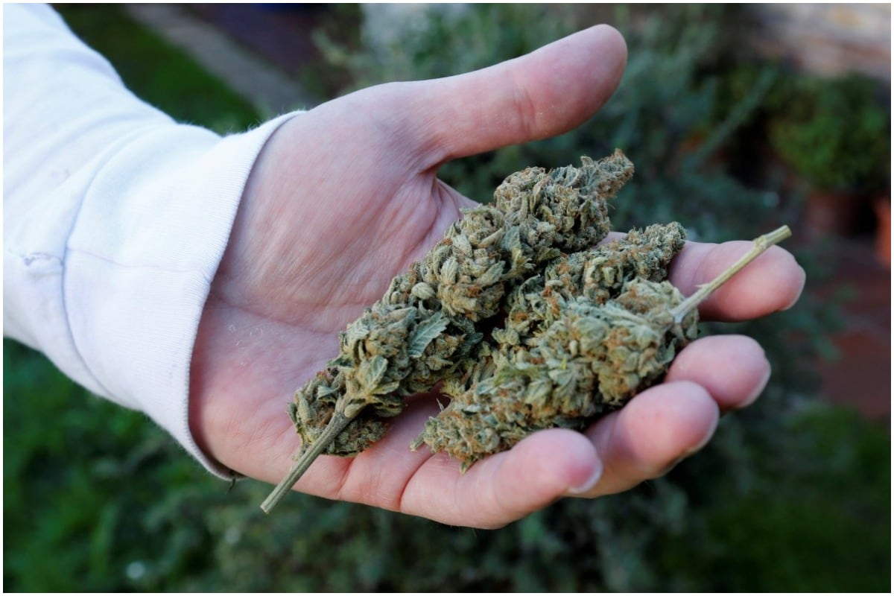

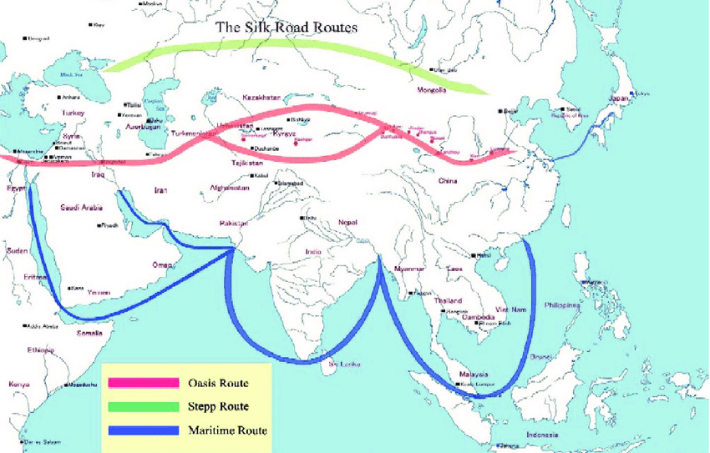







Common Risk: Criminal Activity
Valid coin
Chaff coin
Ransomware
Money laundering
Underground market
3

Slide 8

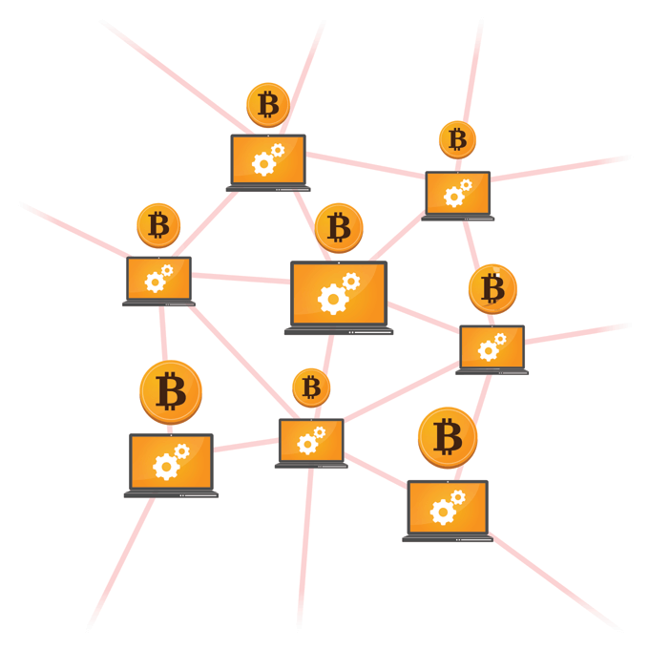
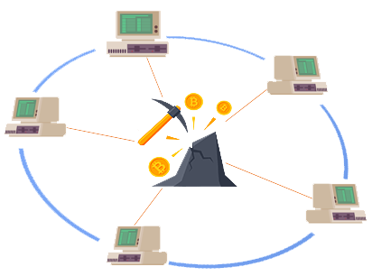
Common Risk: Double Spending
1. TX_{v} is added to the wallet of the targeted vendor
Transaction to vendor
TX_{v}
Transaction to vendor
TX_{v}
Vendor
TX_{a}
Transaction to
colluding address
Attacker
TX_{a}
2. TX_{a} is mined as valid into the blockchain
Transaction to
colluding address
Bitcoin Network
Mining Pool
3. The attacker gets TX_{v} ’s output before the vendor detects misbehavior
3

Slide 9
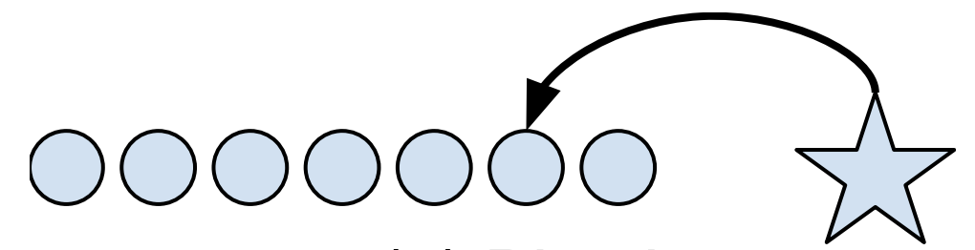
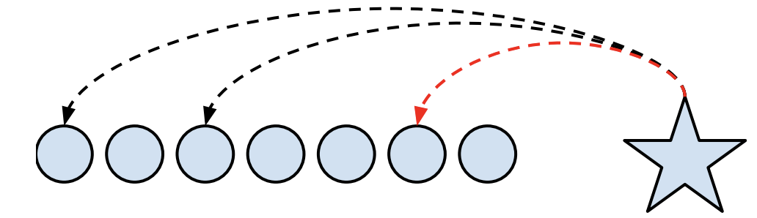
Common Risk: Transaction Privacy Leakage
A new transaction (the star) which spends an available coin (the second circle from the right)
Transactions and tracing in Bitcoin
Transactions and tracing in Cryptonote
Each transaction input explicitly identifies the coin being spent, thus forming a linkage graph
Each transaction input identifies a set of coins, including the real coin along with several chaff coins called “mixins.”
Many mixins can be ruled out by deduction
The real input is usually the “newest” one
3

Slide 10
Selfish Mining Attack
Is bitcoin mining protocol incentive-compatible?
4

Slide 11
Selfish Mining Attack
Others
Block 10
Block 11
Block 12
Block 13
Block 11'
Block 12'
Block 13'
Block 14'
https://link.springer.com/chapter/10.1007/978-3-662-45472-5_28
Mining Pool
4

Slide 12
Selfish Mining Attack
Others
Block 10
Block 11
Block 12
Block 13
Block 11'
Block 12'
Block 13'
Block 14'
Mining Pool
4

Slide 13
Selfish Mining Attack
Pool intentionally forking the chain for keeping discovered blocks private
The honest nodes continue to mine on the public chain
The pool mines on its own private branch
Discovering more blocks by pool develops a longer lead on the public chain, and continues to keep these new blocks private
When the public branch approaches the pool’s private branch in length,
the selfish miners reveal blocks from their private chain to the public
4

Slide 14
Selfish Mining Attack
1. Any state but two branches of length 1, pools finds a block
The pool appends one block to its private branch, increasing its lead on the public branch by one
Revenue from this block will be determined later
11_{pub}
Others' public chain
10
10
Pool's private chain
11_{pool}
12_{pool}
13_{pool}
14_{pool}
11_{pub}
OR
10
10
11_{pool}
11_{pool}
12_{pool}
13_{pool}
14_{pool}
15_{pool}
4

Slide 15
Selfish Mining Attack
2. Was two branches of length 1, pools finds a block
The pool publishes its secret branch of length two
Pool obtains a revenue of two
11_{pub}
11_{pub}
11_{pub}
10
10
10
11_{pool}
11_{pool}
12_{pool}
11_{pool}
12_{pool}
4

Slide 16
Selfish Mining Attack
3. Was two branches of length 1, others find a block after pool head
The pool and the others obtain a revenue of one each - the others for the new head, the pool for its predecessor
11_{pub}
11_{pub}
12_{pub}
10
10
11_{pool}
11_{pool}
4

Slide 17
Selfish Mining Attack
4. Was two branches of length 1, others find a block after others’ head
The others obtain a revenue of two
11_{pub}
11_{pub}
12_{pub}
10
10
11_{pool}
11_{pool}
4

Slide 18
Selfish Mining Attack
5. No private branch, others find a block
Both the pool and the others start mining on the new head
The others obtain a revenue of one
11_{pub}
10
10
4

Slide 19
Selfish Mining Attack
6. Lead was 1, others find a block
There are two branches of length one, and the pool publishes its single secret block
The revenue from this block cannot be determined yet
11_{pub}
11_{pub}
10
10
10
11_{pool}
11_{pool}
11_{pool}
4

Slide 20
Selfish Mining Attack
7. Lead was 2, others find a block
The pool publishes its secret blocks, causing everybody to start mining at the head of the previously private branch
Pool obtains a revenue of two
11_{pub}
12_{pub}
11_{pub}
10
10
11_{pool}
12_{pool}
13_{pool}
11_{pool}
12_{pool}
13_{pool}
11_{pub}
12_{pub}
10
11_{pool}
12_{pool}
13_{pool}
4

Slide 21
Selfish Mining Attack
8. Lead was more than 2, others win
The pool now reveals its i’th block
Pool obtains a revenue of one
11_{pub}
10
10
11_{pool}
12_{pool}
13_{pool}
11_{pool}
12_{pool}
13_{pool}
11_{pub}
10
11_{pool}
12_{pool}
13_{pool}
4

Slide 22
Eclipse Attack
Is the bitcoin peer-to-peer network safe?
5

Slide 23


Eclipse Attack
Normal nodes
To be victim node
5

Slide 24

Eclipse Attack
Normal nodes
Attacker
node
Victim node
5

Slide 25
Eclipse Attack
Attacker
nodes
Normal nodes
Victim node
5

Slide 26
Eclipse Attack
Victim node
Attacker node
Off-path attack - attacker controls end-hosts, but not key network infrastructure between the victim and the rest of the bitcoin network
Rest of network
5

Slide 27
Eclipse Attack
Benefit: 51% attack with 40% mining power
30% < 40%
40% Hashing power
40% >30%
30% Hashing power
30% Hashing power
Attacker partitions miners so they can't build on each other blocks
The attacker then outcompetes each partitioned miner
5

Slide 28
Eclipse Attack
Attacker populates the victim node's peer tables with attacker's IP addresses
Victim node restarts and loses current outgoing connections
The victim establishes all new outgoing connections to attacker IP addresses
5

Slide 29
Eclipse Attack
1. Populating of IP addresses
Each node picks its peers from IP addresses stored in two tables
New table: IPs the node has heard about
Tried table: IPs the node peered with some point
The tables also store a timestamp for each IP
Each table stores the IPs in buckets
To find an IP to make an outgoing connection to:
Choose new or tried table to select from
Select an IP with newest timestamp
Attempt an outgoing connection to that IP
Attacker populates tables with attacker IPs so that the victim node only connects to the attacker IPs
Selection Bias: Attacker ensures its IPs are the newer one
5

Slide 30
Eclipse Attack
2. Restarting node event is natural?
Software/security updates
Packets of death/DoS attacks
Power/network failures
ISP outages
5

Slide 31
Eclipse Attack
3. Bucket eviction
The bucket is full, and an IP is inserted into it
Randomly selects 4 IPs
Delete oldest IP
Insert new IP
Eviction Bias: Attacker IPs will always have the most recent timestamps
Try-Try-Again: If an attacker IP replaces another attacker IP, the evicted IP is resend and eventually replaced by honest IP
5

Slide 32
Front-running Attack
3. Buy (1000)
Gas Price = 50 Gwei
Attacker
2. Detects
Buy (1000)
1. Buy (1000)
Gas Price = 5 Gwei
Ethereum Network
Alice
Notes:
The front-runner upon spotting the profitable transaction Buy(1000) sends his own transaction with higher gas price to bribe the miners to prioritize his transaction over initial transaction.

Slide 33
Front-running Attack
Front-running Attack
Displacement
After Attacker's run, Alice's function call is not important to the attacker
Insertion
After Attacker's run, the state of the contract is changed. Alice's function call is needed to run on this modified state
Suppression
After Attacker's run, she tries to delay Alice's function call. After the delay, Alice's function call is indifferent to the attacker

Slide 34
Front-running Attack
Front-running Attack (Displacement / Insertion / Suppression)
Asymmetric
Alice is trying to cancel an offer, and Attacker is trying to fulfill it first
Bulk
Attacker is trying to run a large set of functions and Alice is trying to buy a limited set of shares offered by a firm on a blockchain

Slide 35
Front-running Attack
Markets and Exchanges:
Spotting a profitable cancellation transaction
(Unordered) mempool
Reordered Block
[…]
Cancel (order 100)
Breed (cryptokittie 1, cryptokittie 2)
Buy (order 101)
Bid (B_{j})
Register (B_{i})
[…]
Block Height #N
Register (B_{i})
Buy (order 100)
Cancel (order 100)
Buy (order 101)
Bid (B_{j})
Breed (cryptokittie 1, cryptokittie 2)
Adversarial miner mines a block with preferred order
Ethereum Network
Notes:
The adversarial miner monitors the Ethereum mempool for decentralized exchange transactions. Upon spotting a profitable cancellation transaction, he puts his buy order prior to the cancel transaction in the block he mines. Doing so, the miner can profit from the underlying trade and also get the gas included in the cancel transaction.

Slide 36
Front-running Attack
Gambling:
Bribing miners for prioritizing themself
When the timer of Fomo3D game reached about 3 minutes, the winner bought 1 ticket and then sent multiple high gasPrice transactions to her own DApps
Users
Transactions congested the network
Bribed miners to prioritize them ahead of any new ticket purchases in Fomo3D
Attacker DApps
Notes:
The adversarial miner monitors the Ethereum mempool for decentralized exchange transactions. Upon spotting a profitable cancellation transaction, he puts his buy order prior to the cancel transaction in the block he mines. Doing so, the miner can profit from the underlying trade and also get the gas included in the cancel transaction.

Slide 37
Tesseract (CCS ‘19)
Tesseract - Secure Real Time Crypto Currency Exchange (ACM CCS ’19)
Centralized exchange designs are vulnerable to theft of funds
Decentralized exchanges cannot offer real-time cross-chain trades
Tesseract - Real time - as fast as centralized exchanges
Can observe the buy (a.k.a. “bid”) and sell (a.k.a. “ask”) prices in real time and allow parties to modify their trading positions in milliseconds.
Supports cross chain asset exchanges
Secure against theft by exchange operators

Slide 38
Tesseract - Overview
Tesseract (CCS ’19)
Tesseract relies on a Trusted Execution Environment (TEE)
TEE enables Tesseract to behave like a trusted third party, controlling funds without exposing them to theft while preventing frontrunning by the exchange operator
Ensures all-or-nothing settlement

Slide 39
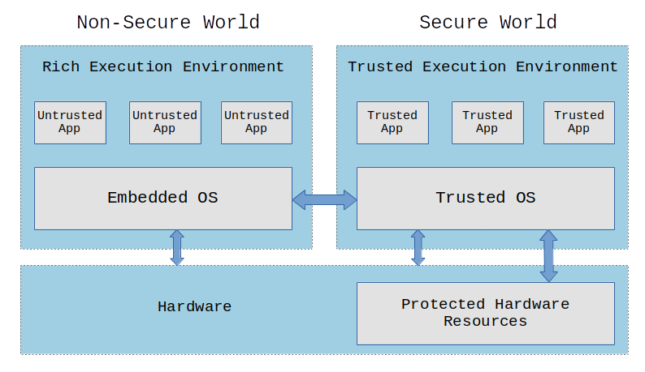
Trusted Execution Environment - TEE
Tesseract (CCS ’19)
TEE is a secure area of a main processor (Refer to Intel SGX – Software Guard Extensions)
Guarantees code and data loaded inside to be protected with respect to:
Isolated execution
Integrity of applications
Confidentiality of their assets
Provides attestation that an output represents the result of such an execution in the TEE
https://embeddedbits.org/introduction-to-trusted-execution-environment-tee-arm-trustzone/

Slide 40
Tesseract - Threat Model
Tesseract (CCS ’19)
Assumes the security of TEE and remote attestation
Code that runs inside the TEE enclave can neither be observed nor tampered with
Strong network adversary that can gain complete OS and network control of the host in which the funds are stored
Adversary’s goal is to maximize her profit

Slide 41
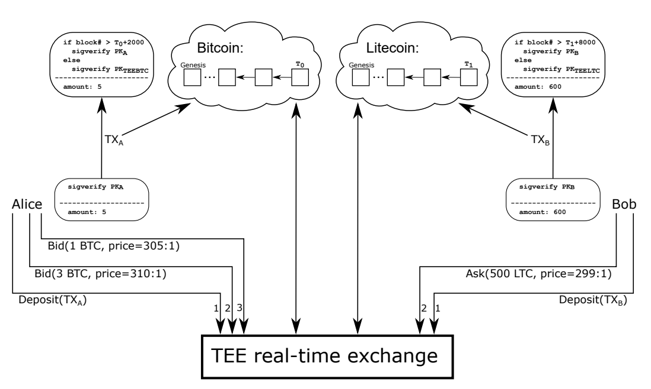
Tesseract - Design
Tesseract (CCS ’19)
Tesseract configured with Bitcoin and Litecoin networks. The TEE forms the secure real-time exchange with which the parties interact to carry out asset swaps.

Slide 42
Tesseract - Steps
Tesseract (CCS ’19)
1
Initialization of exchange
Tesseract enclave is running light blockchain clients (SPV – Simplified Payment Verification clients).
During initialization, the enclave fetches the latest blockchain state.
The enclave then invokes a key generation procedure to create a keypair (sk, pk) for each supported cryptocurrency.
The enclave will then attest pk as its deposit address, for each cryptocurrency.
The attested pk keys are published through multiple services - (such as websites, IPFS, and even Bitcoin and other blockchains).
The pk also forms the depositor address for Tesseract exchange in the corresponding cryptocurrency.
https://en.bitcoinwiki.org/wiki/Simplified_Payment_Verification

Slide 43
Tesseract - Steps
Tesseract (CCS ’19)
2
User Initialization
A new user opens a Tesseract account by depositing a significant amount into a deposit address of the exchange.
The proof of deposit is sent to the enclave in the form of the transaction, index of block, and Merkle tree.
Tesseract credits the user’s account (in the enclave) after verifying the deposit.
Tesseract also protects against replay attacks, by requiring strictly increasing block indices for the user’s deposits.
Each user account is identified by the user’s public key and hence the user can use its secret key to generate signed messages to interact with Tesseract.

Slide 44
Tesseract - Steps
Tesseract (CCS ’19)
Asset Exchange
Users post buy or sell orders along with their exchange rate. Orders are recorded in the enclave. Eg: Bob bids to sell LTC for the price of 299 LTC per BTC Alice bids to buy LTC price of 305 LTC per BTC.
Tesseract server publishes an anonymized version of the order book with remote attestation.
Realtime trading is executed by matching the buy and sell orders.
The trade results do not reflect in the blockchain networks immediately, and are only reflected in the tesseract exchange sandbox.
Periodically, settlement transactions are issued by tesseract in the blockchain networks to update users’ balance.
Tesseract exchange can be configured to collect a proportional fee for each successful trade (e.g 0.1% of amount). This will help in exchange owners to maintain their infrastructure.
3

Slide 45
Tesseract - Eclipse Attacks
Tesseract (CCS ’19)
Resistance against Eclipse Attacks is the most interesting aspect of Tesseract.
Tesseract enclave is preloaded with the current difficulty parameter of each PoW-based blockchain.
This can be further verified by users before using the Tesseract exchange.
Assume adversary A controls < ½ of computational power.
A has total control over the network
Eclipse Attack:
A cuts the enclave off from the Bitcoin network and presents it with a fake blockchain containing a deposit transaction TX_{fake}
Tesseract monitors the rate at which blocks are being mined in the network. (e.g. ~10 minutes for bitcoin)
Fixed difficulty parameter -> A cannot change the difficulty, and forced to mine at the current difficulty.
A cannot mine at the required rate ( since A controls < ½ of computational power of main network).
TEE has a trusted clock. Attack is detected by Tesseract.

Slide 46
Tesseract - Eclipse Attacks
References
https://www.sciencedirect.com/science/article/pii/S0167739X17318332?casa_token=-Os8D6Mop7AAAAAA:NU-biO_avee1LRnqJ-6Aycw3yoQWhcWle0WdXaha3O-Dl2qPgl6EBZ0laOiJQQPpyi_6lVZ_ig8
https://ieeexplore.ieee.org/abstract/document/8369416?casa_token=Y4DlRAdrVA0AAAAA:AsbmBNQugd6EcGIN_JKgcqI8AThFdIyhSCIkAiwO3JL6nVWrAeZDHyj4oyqxQ475ZO8saES-ReI
https://link.springer.com/chapter/10.1007/978-3-662-45472-5_28
https://www.usenix.org/system/files/conference/usenixsecurity15/sec15-paper-heilman.pdf
https://link.springer.com/chapter/10.1007/978-3-030-43725-1_13

